Slide 1

Smart Traffic Optimizer: Generative AI for Urban Mobility
Eduardo Cabrera-Lopez ITAI 3377 – Capstone Project August 4, 2025

Slide 2

Use Case Overview
Problem: Cities face traffic congestion, emergency delays, and inefficient signals.
Solution: An edge-based autonomous agent that uses generative AI to predict traffic patterns and optimize light signals in real time.
Benefits: ✓ Reduces congestion ✓ Improves safety ✓ Lowers emissions ✓ Prioritizes emergency vehicles

Slide 3
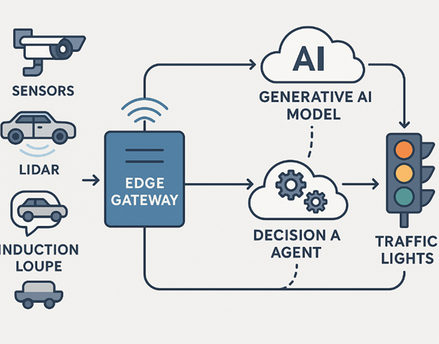
System Architecture
System Flow: Sensors → Edge Device → AI Engine → Traffic Signals
Components:
Sensors: Cameras, LIDAR, Induction Loops
Edge Gateway: Raspberry Pi / Jetson Nano
AI Model: Generative + Reinforcement Learning
Communication: MQTT, HTTPS/TLS
Security: Encryption, Role-Based Access

Slide 4

Generative AI Model
Model Breakdown:
Generative Component: Predicts traffic flow using diffusion model or GAN
RL Agent: Chooses the best light sequence for next 60–120 seconds
Backup Logic: Handles sensor failures and edge cases
Conceptual Tools:
TensorFlow Lite
Edge Impulse
Google Colab

Slide 5

Security & Ethics
Security Measures: ✓ TLS encryption for all data ✓ Device authentication ✓ Firmware signing ✓ Local processing for privacy
Ethical Considerations: ✓ License plate blurring ✓ Bias audits for fairness ✓ Transparency via explainability logs ✓ Edge autonomy to avoid centralized abuse

Slide 6

Testing Plan (Theoretical)
Test Scenarios:
Morning rush hour simulation
Emergency vehicle prioritization
Sudden road blockage
Metrics:
Average vehicle delay
Throughput rate
Response time
Edge device performance
Tools: Node-RED or SUMO (urban traffic simulator)

Slide 7

Challenges & Lessons
Challenges:
Latency vs. model complexity
Data diversity
Privacy and real-time constraints
Device-level compute limitations
Lessons Learned:
Edge-AI must be efficient, privacy-preserving, and robust
Generative AI enables proactive decision-making
Clear planning reduces ethical and technical risk

Slide 8
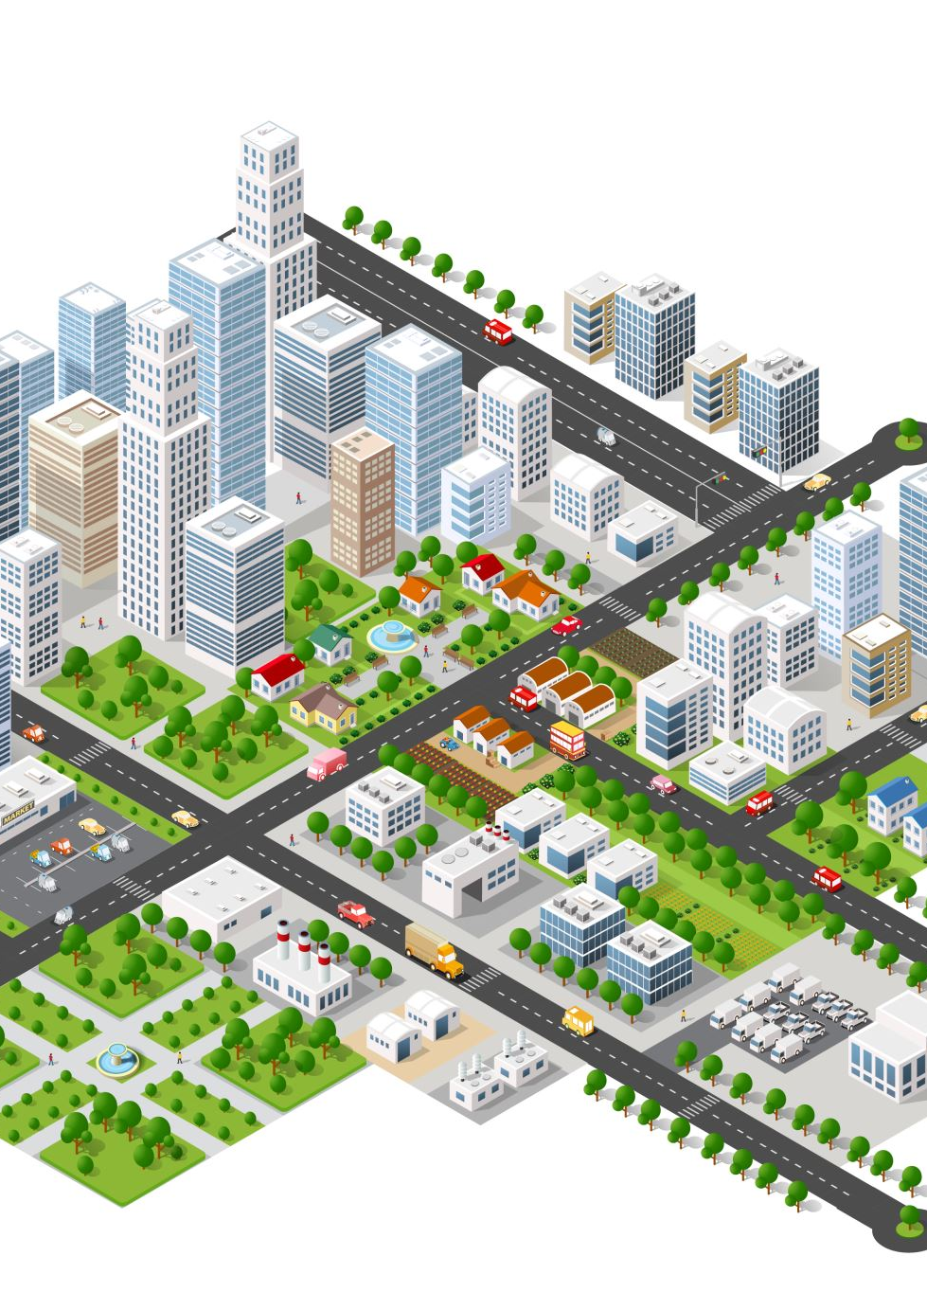
Conclusion
The Smart Traffic Optimizer shows how generative AI and autonomous edge agents can change how people get around in cities. This idea offers a feasible and scalable way to make cities smarter and safer by using predictive capabilities, local decision-making, and ethical safeguards.

